Slide 1
EC544 Team 1 – Challenge 8
Abdulaziz Alhassan
Konstantino Sparakis
Wenyng Zhang

Slide 2
Design Strategy
Left & Right sensor for wall following & gap detection
Gap detection to detect corners
Autonomous Functions was to follow a fall until there is a gap then the car stops and waits for human commands
We did this because our turning function was not very effective
Android app for human control
Skype for web cam view

Slide 3
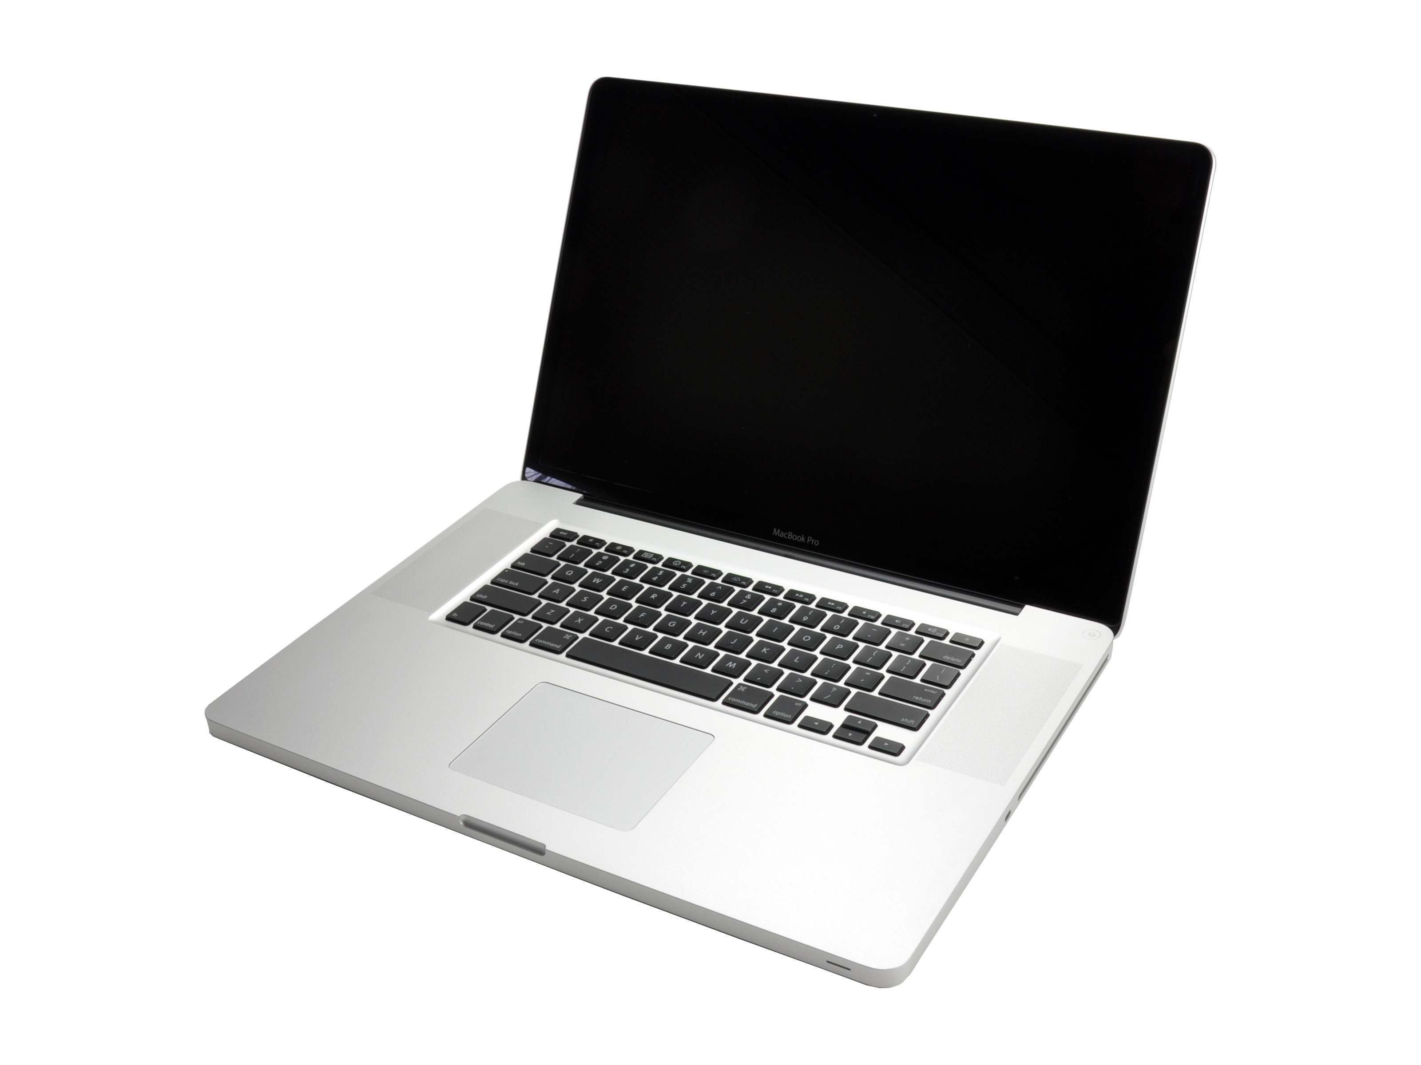
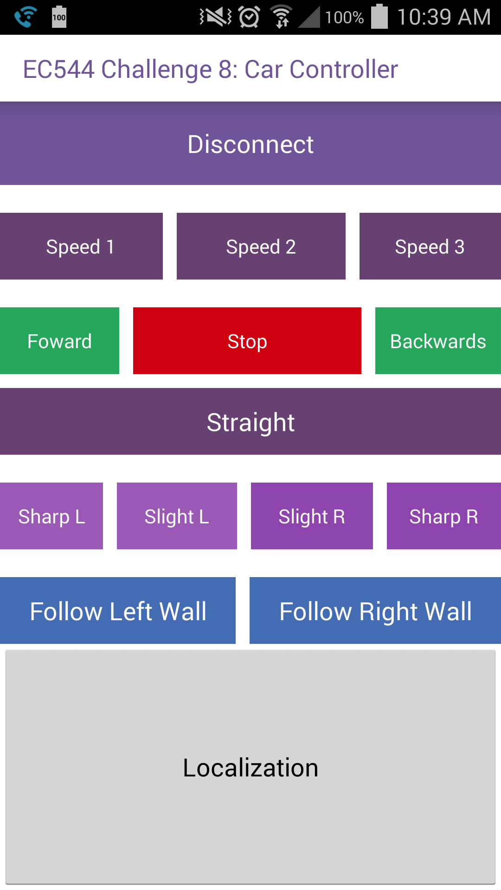
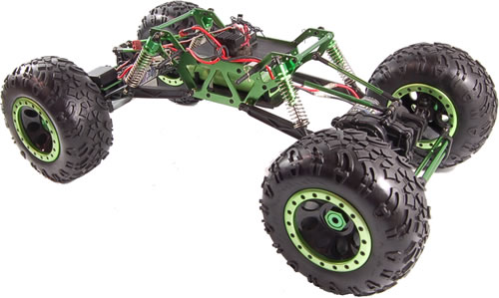
Dataflow
Cellphone to laptop
web cam with Skype
TCP connection using
DDNS
Basestation – Spot
Datagram communication

Slide 4
Android App
Sends data to basestation through TCP
DDNS setup for connecting app with basestation
Autonomous Functions include Follow Left wall and Follow Right wall
When under Autonomous function only stop command works.
Follows Wall until a gap is detected.
Calculates Localization

Slide 5
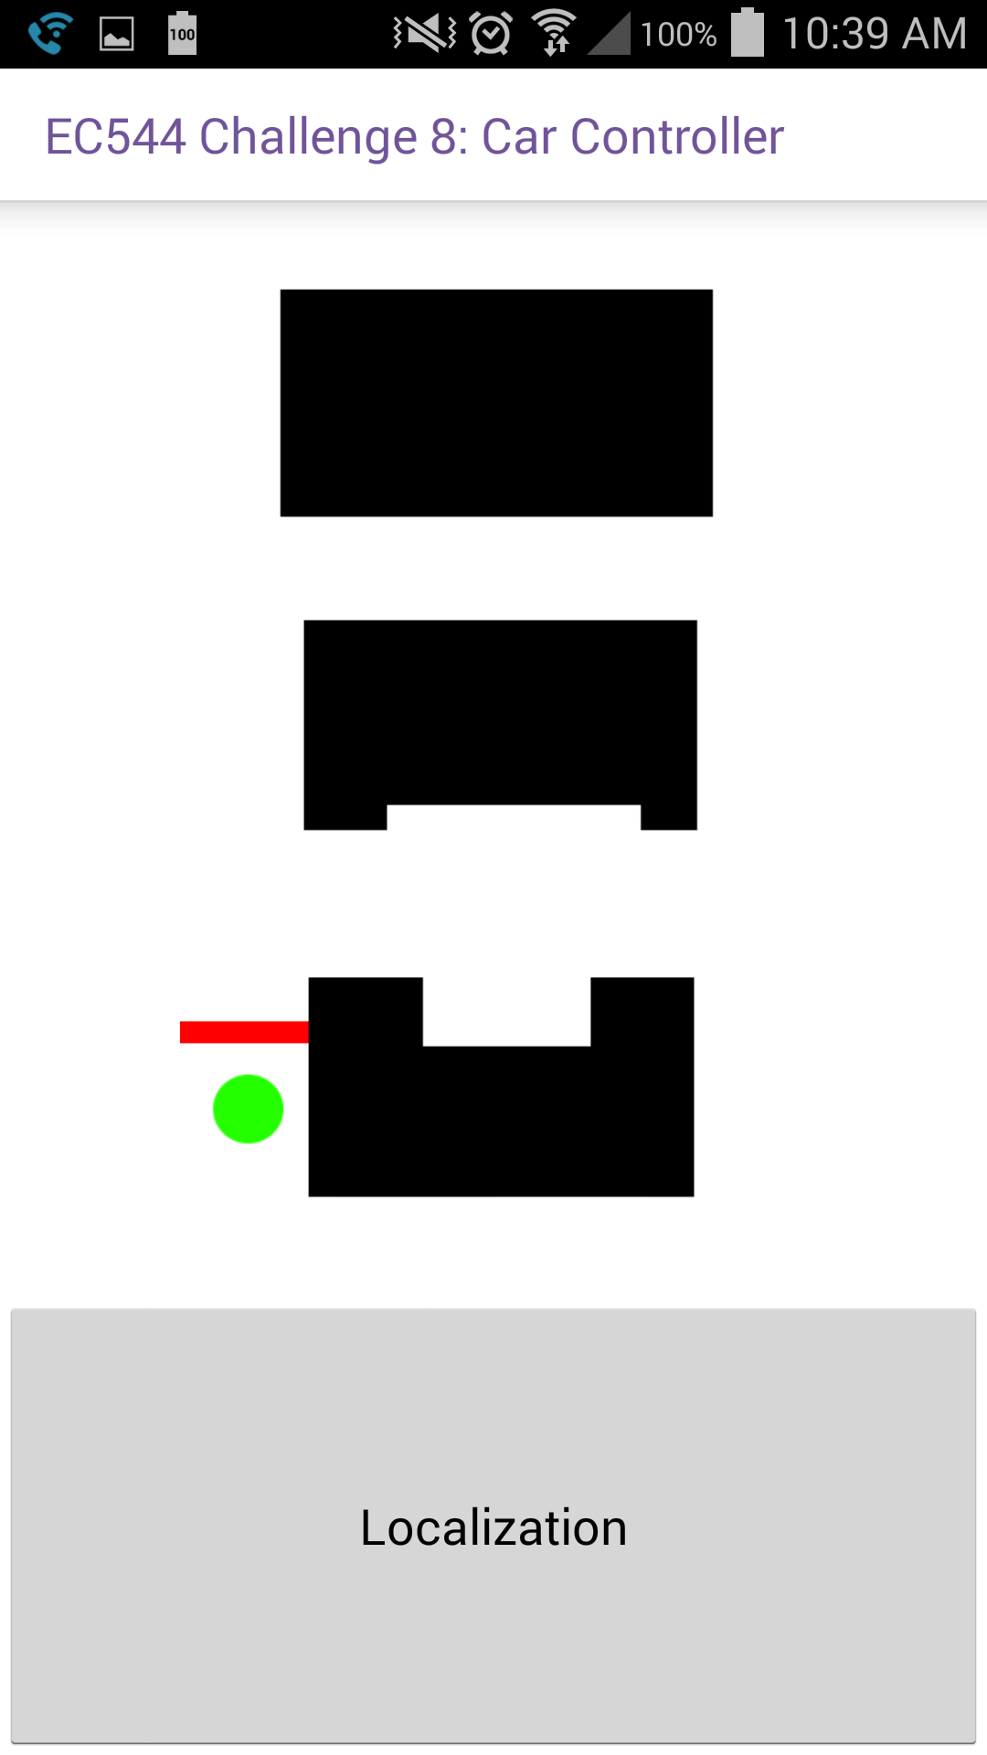
Localization
In app localization
Approximates location of car by using the gap count to assume where the car is and where it is moving
Problem with this is that if gap count messes up the car will show that it is farther than it really is.

Slide 6
Web Cam
Used cell phone connected to wifi and Skype
Had phone mounted as far back as possible as a 3rd person view of the car was more useful for controlling

Slide 7
Technologies Used
Android
Tcp
No-IP.com free DDNS
Skype

Slide 8
Challenges
Base station are not able to send data through the ports in latest version of mac OSX 10.10. There seems to be a security issue blocking the sdk from sending data from the port numbers.
Getting Beacons to report back to Base station while receiving commands, was very difficult to implement.

